Slide 1

Instagram strategy for eleve dancewear
By: Marissa Doke

Slide 2
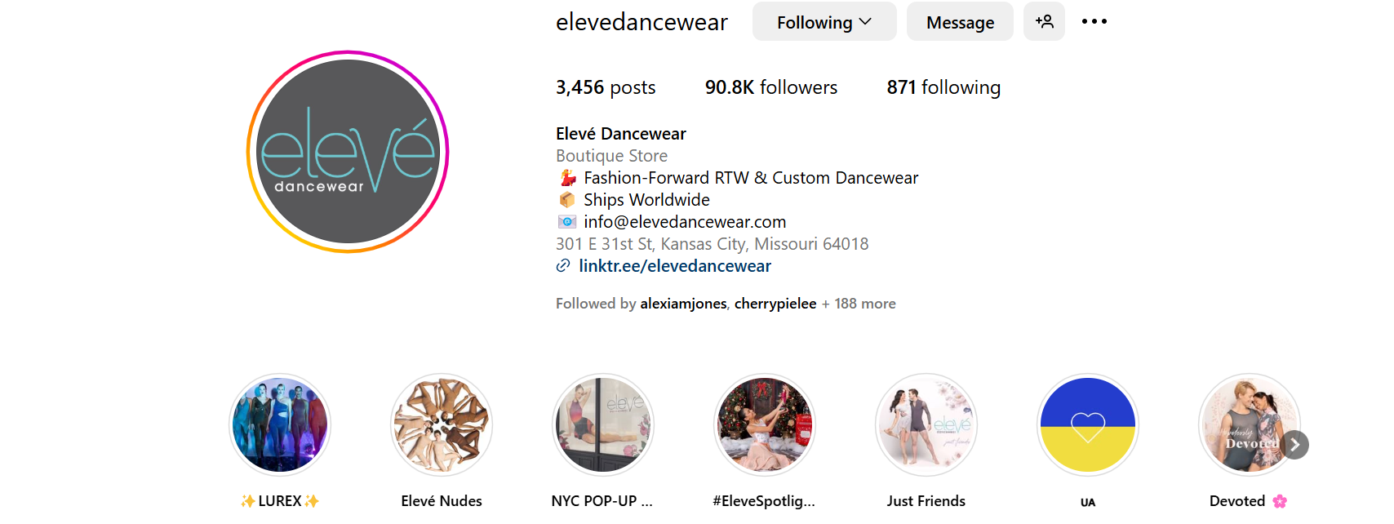
Eleve’s instagram

Slide 3
Eleve’s presence on Instagram
Elevé Dancewear (@elevedancewear) • Instagram photos and videos
Stats:
  Followers: 90.8K
  Average posts: every 1-2 days
  Average likes: 100-500

Slide 4
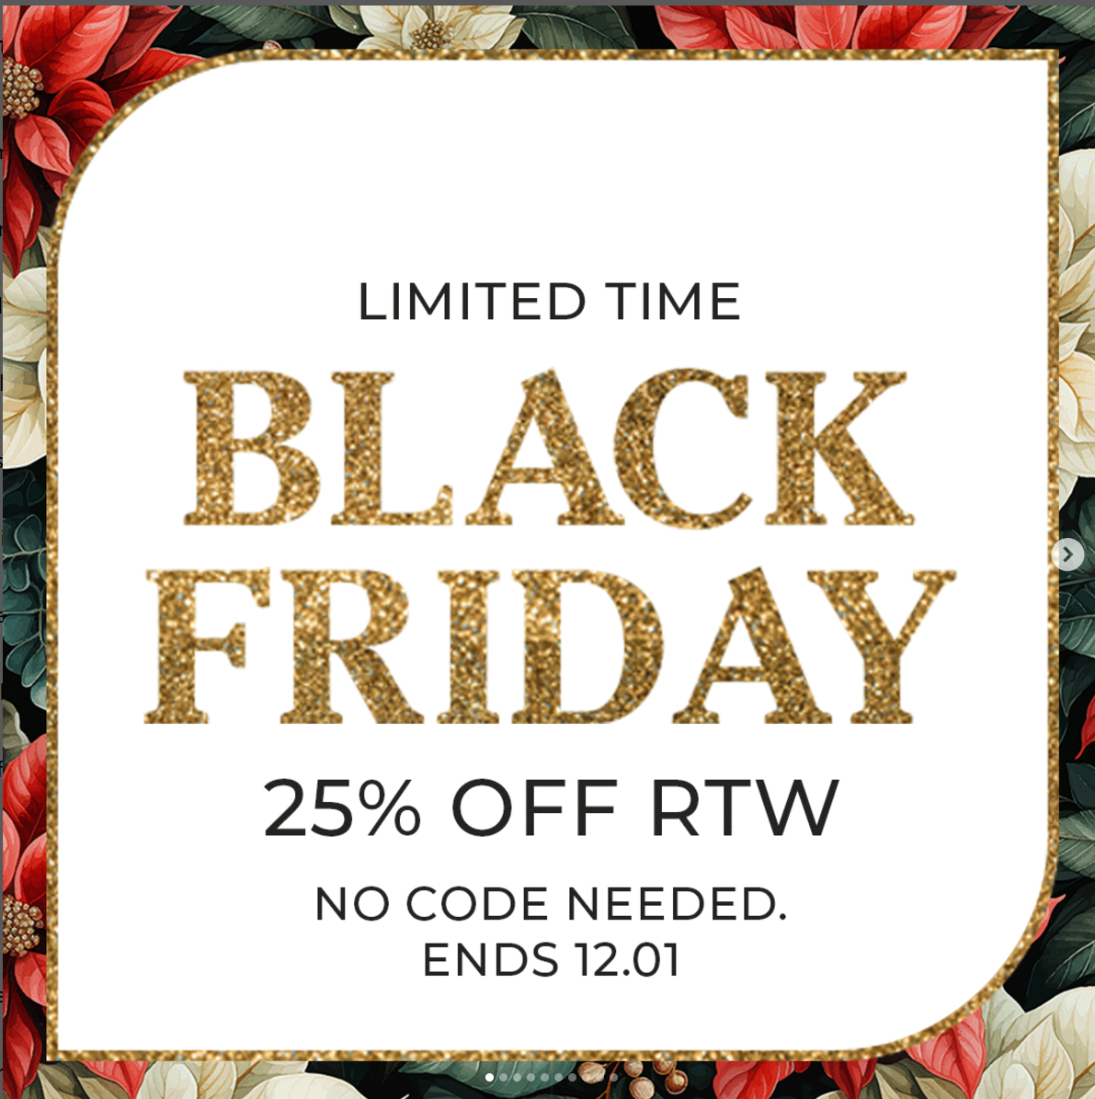
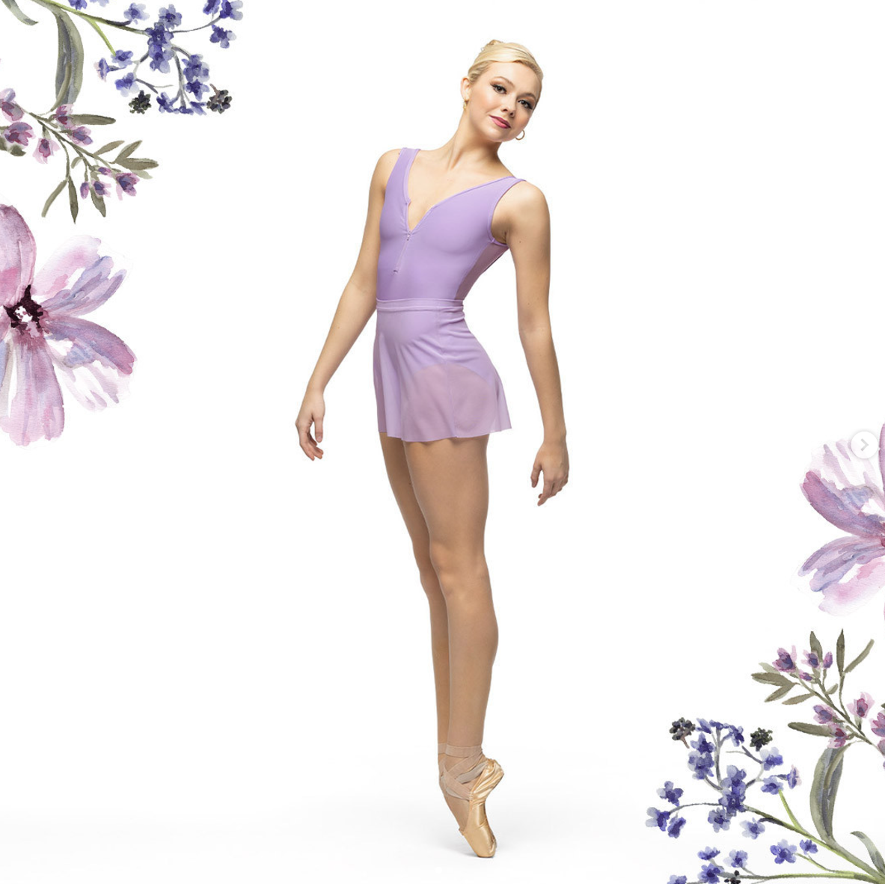
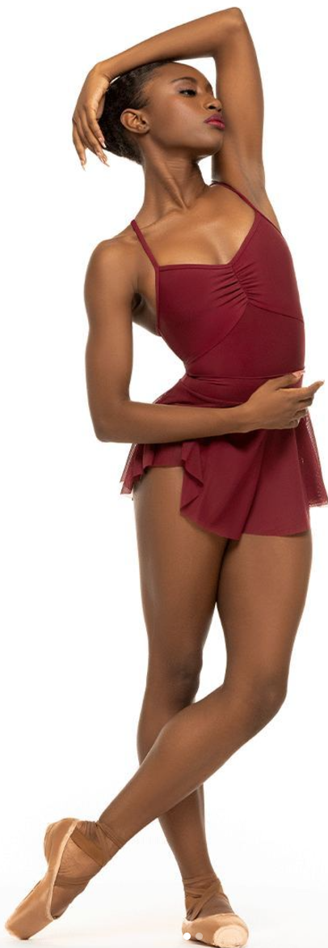
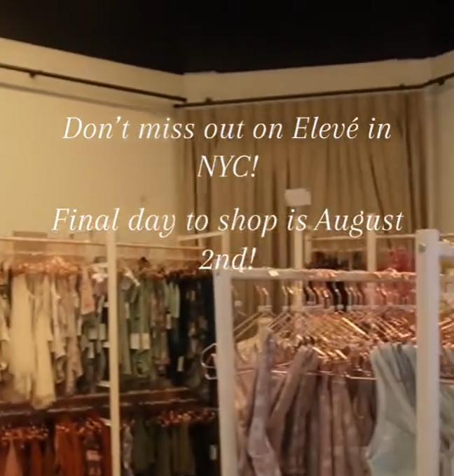
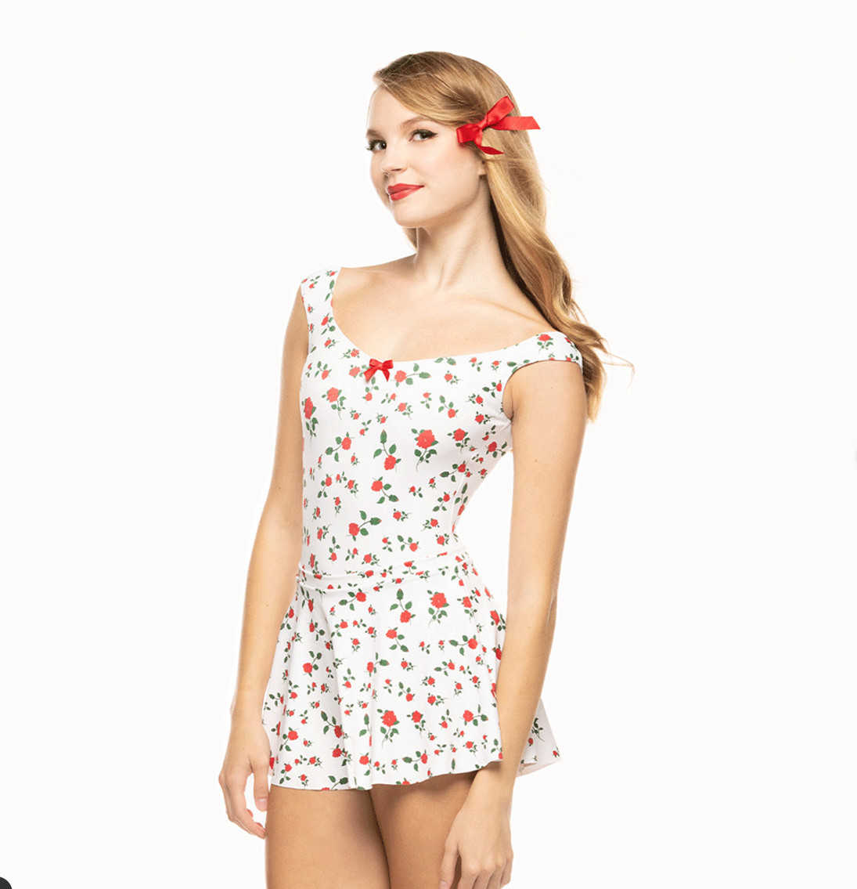
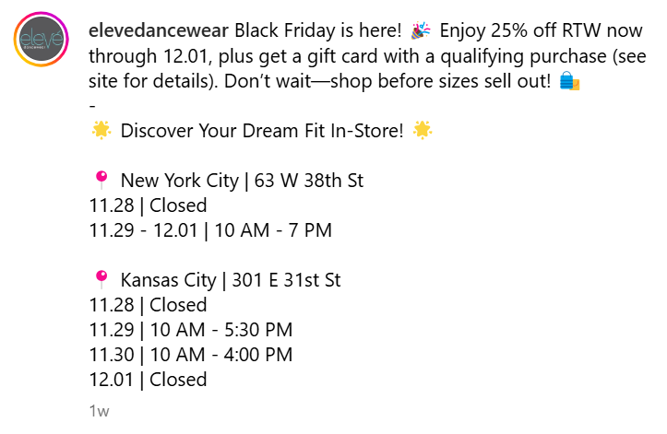
Current content
Simplistic design
Sales
Pop up shops

Slide 5
Swot analysis
 | Helpful | Harmful
Internal Origin | Loyal Followers Worldwide Shipping Special Occasion products | Price Not aware of their clientele
External Origin | Brand Alliances Big Partnerships | Big Competitors Less expensive competition

Slide 6
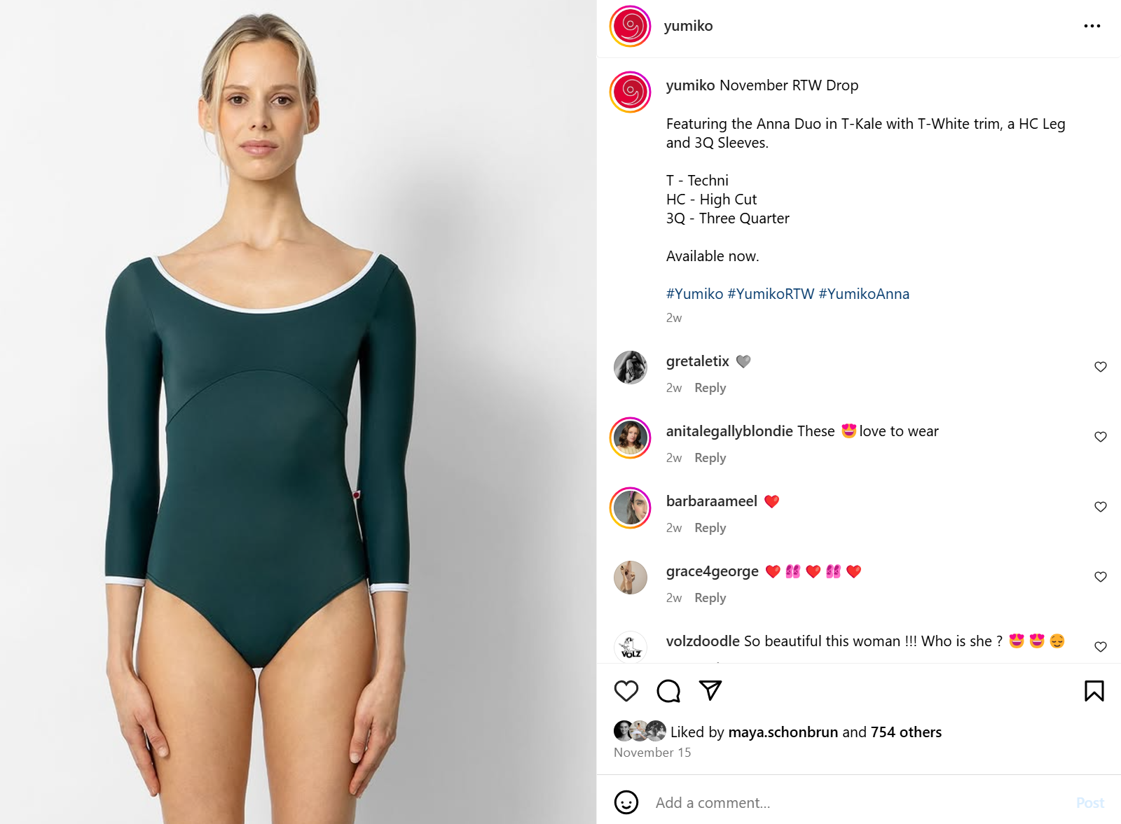
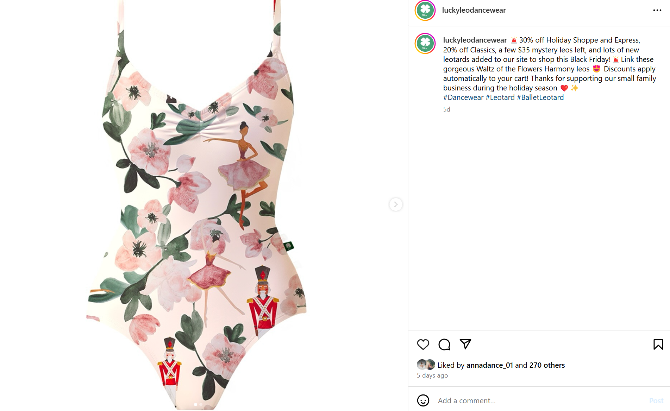
Competitors
Yumiko
Followers: 80.6K
Average posts: Once a week
Average likes: 400 – 1,000
Luckyleo
Followers: 103K
Average posts: 2-3 posts every day
Average likes: 200 – 2,000

Slide 7
The audience: eleve’s current and target Instagram audiences

Slide 8
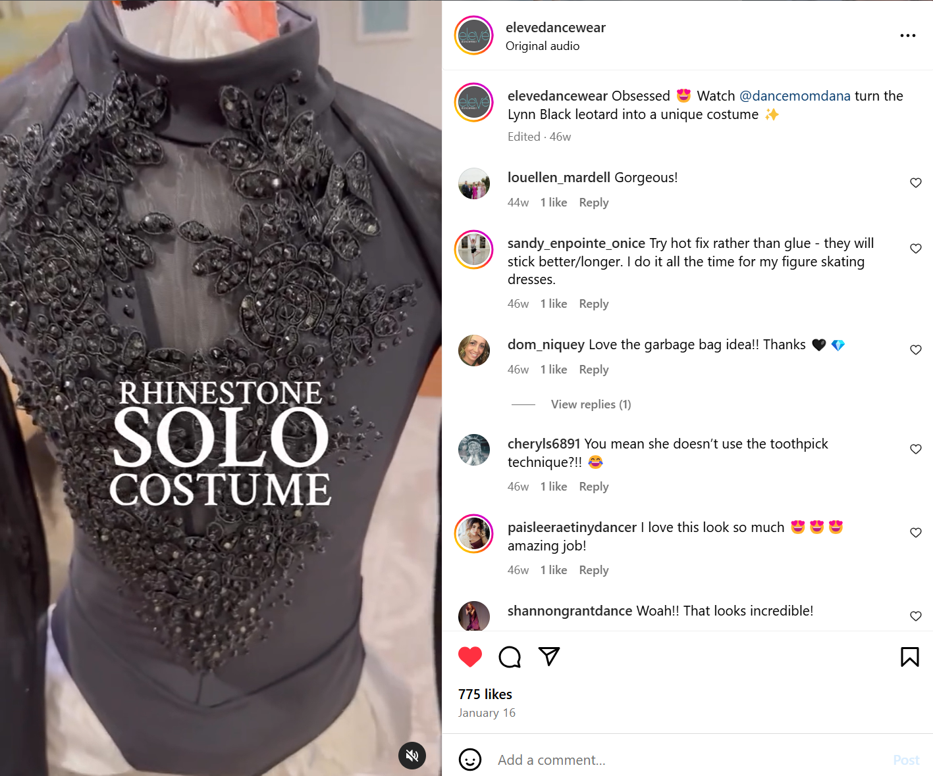
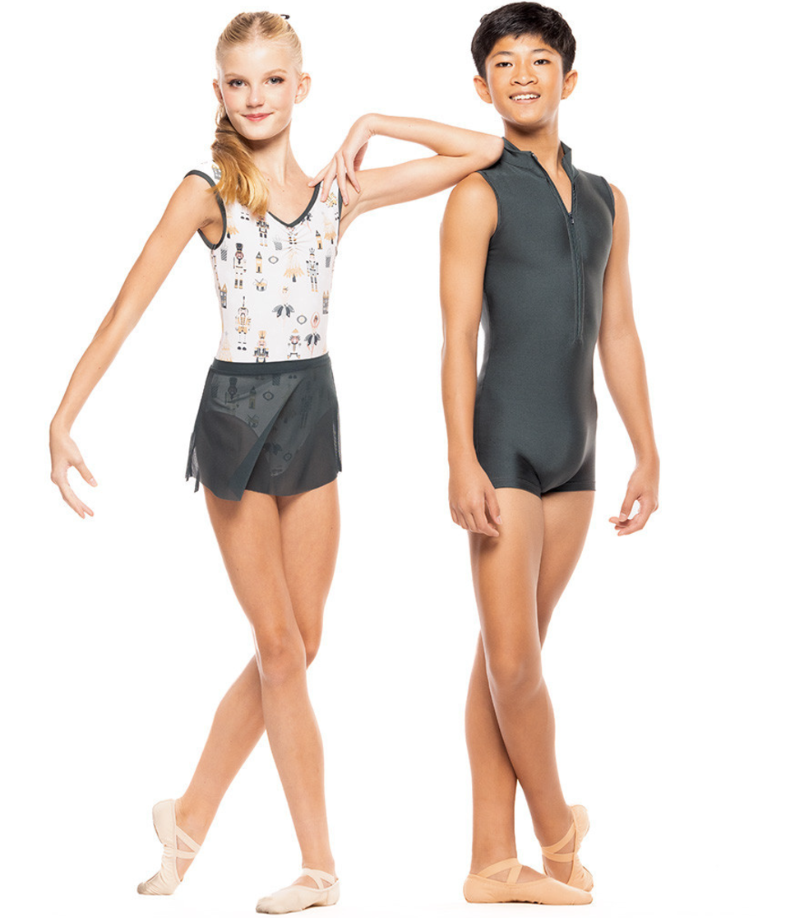
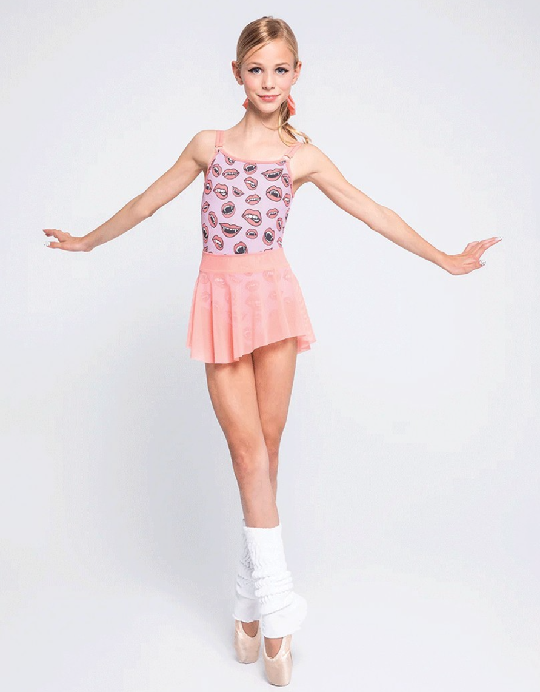
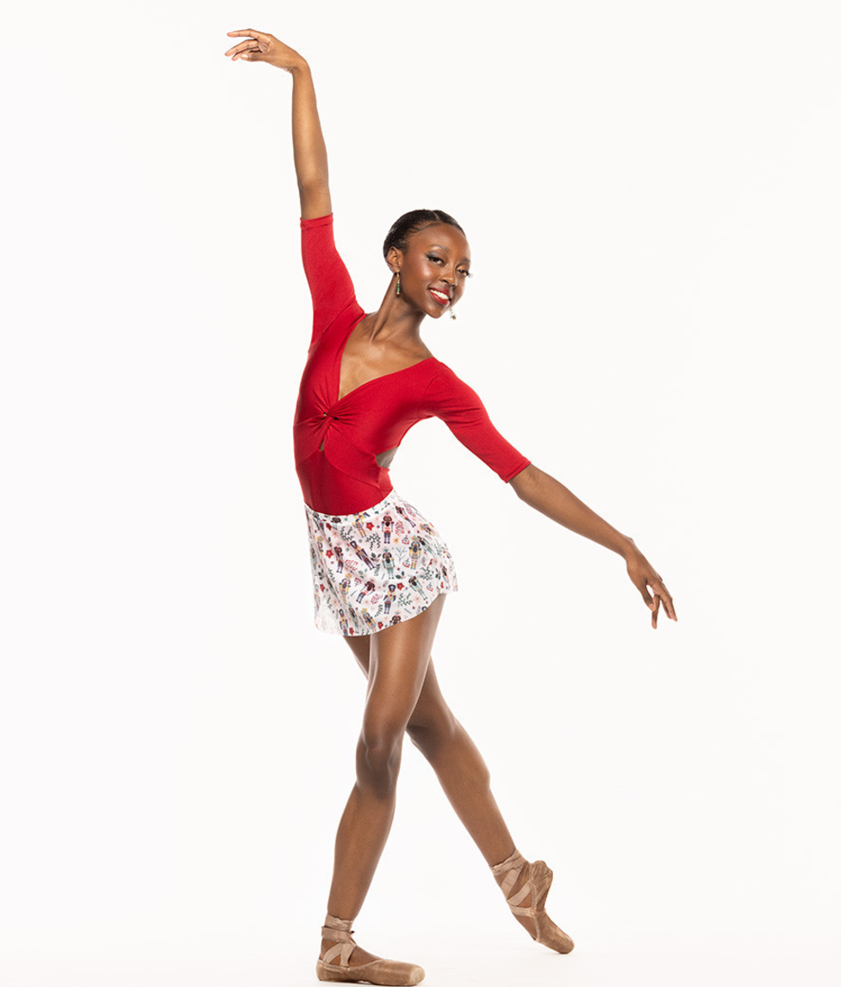
Current audience
Ballet dancers ages 12-18
Parents of young ballet dancers

Slide 9
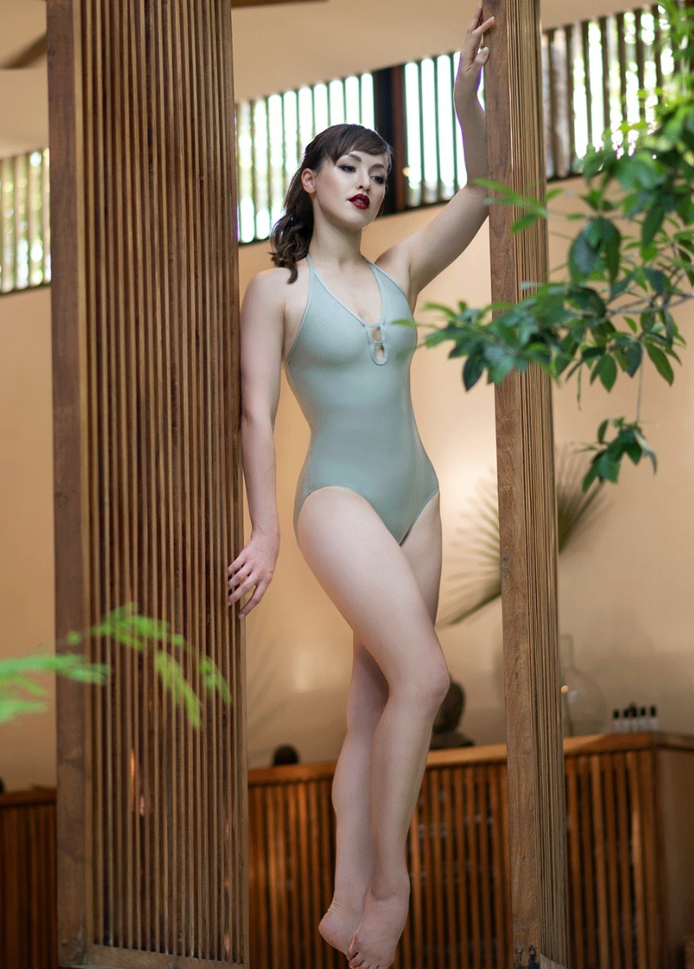
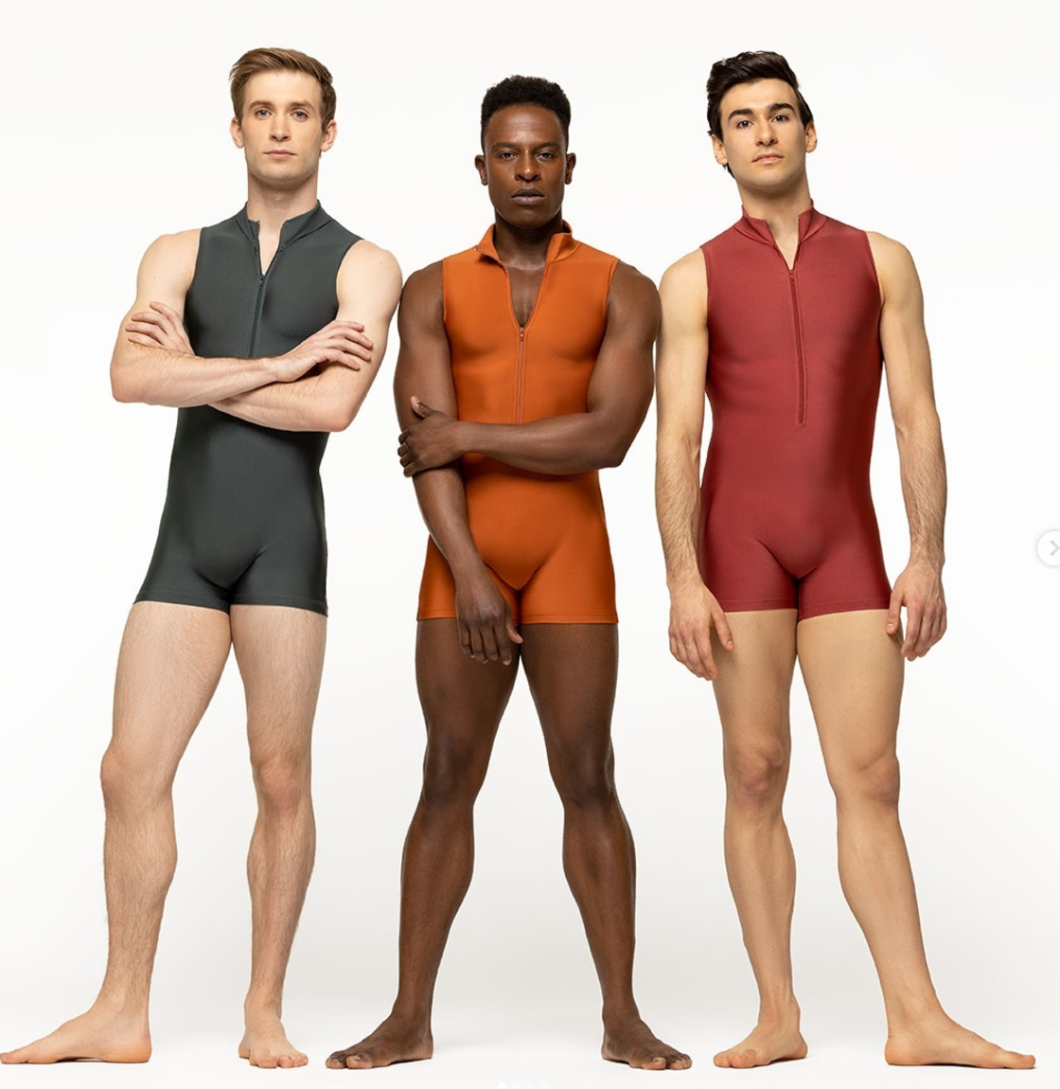
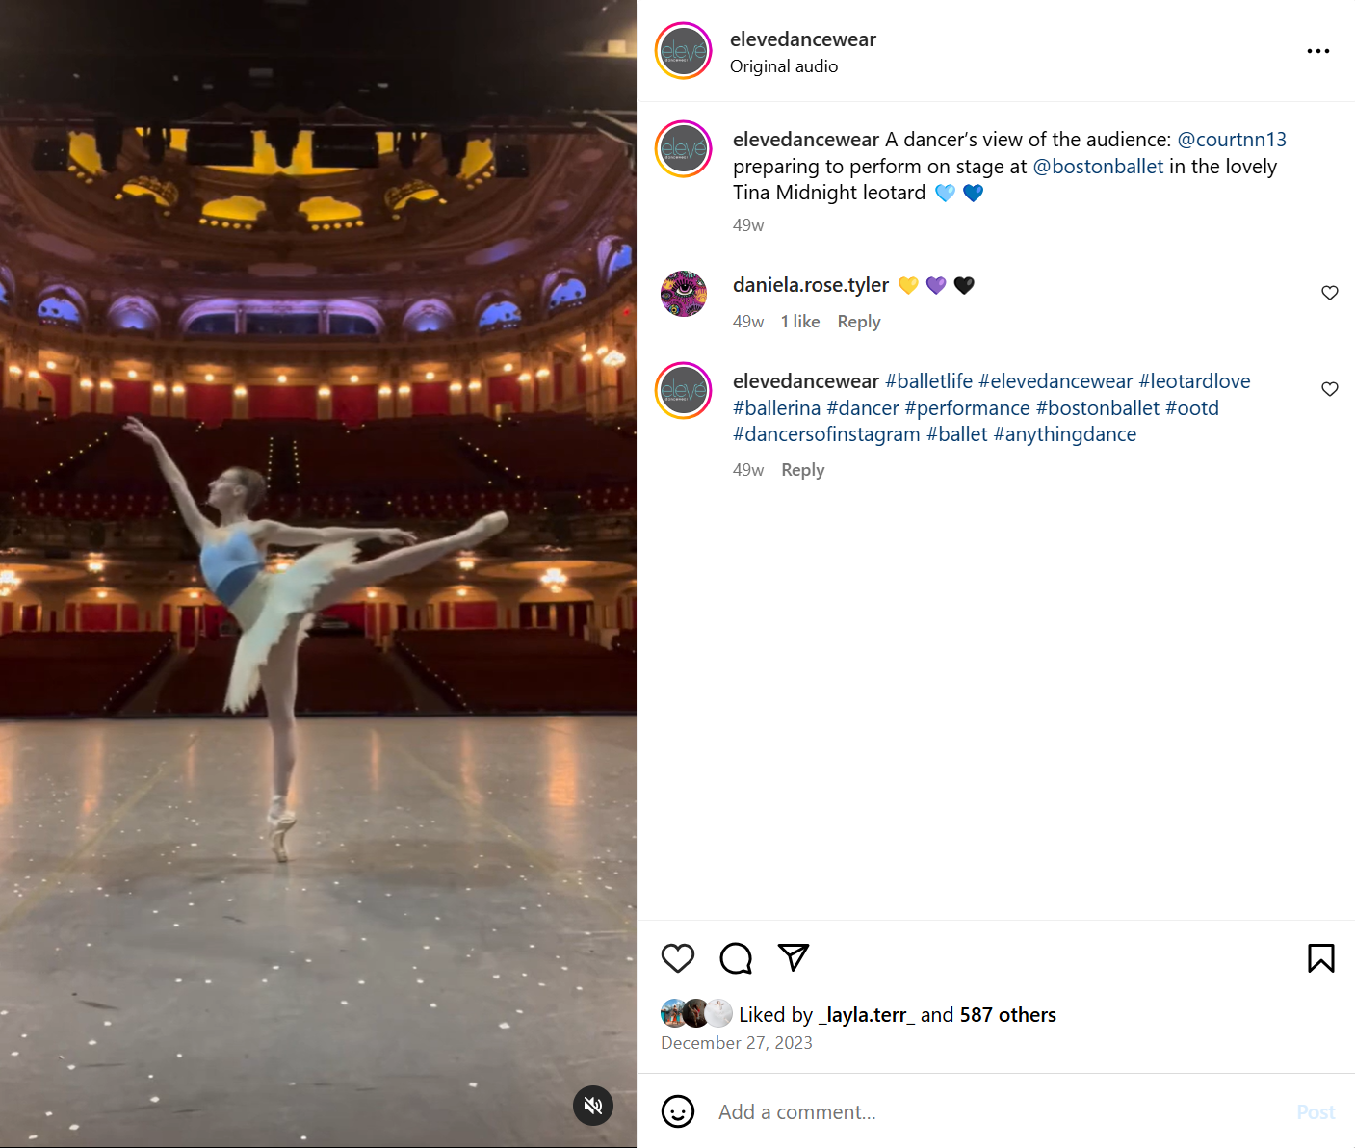
Target audience
Professional dancers
  Ages 20-30
  75% female 25% male
  United States

Slide 10
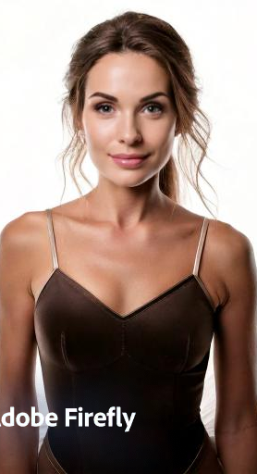
Meet Jessica duke
25-year-old professional dancer
Lives in New York City
Salary: $90,000 a year
Graduated from Butler University with a double major in Elementary Education and Dance
Works in childcare when not working as a Rockette in the winter

Slide 11
Eleve dancewear’s goals

Slide 12
goals
SWOT connection to target audience
Expensive
Brand Alliances
SMART Goal
S: Increase customers ages 20-30 by continuing to push sales
M: Achieve a 25% increase in sales
A: Create an alliance with professional dancers as many other companies do
R: Providing a discount to working dancers will make them more inclined to buy your products
T: 6 Months
This would fall into the awareness step of the funnel
KPI
Conversion Rate
Website Traffic

Slide 13
The plan: strategies and tactics for achieving eleve’s Instagram goals

Slide 14
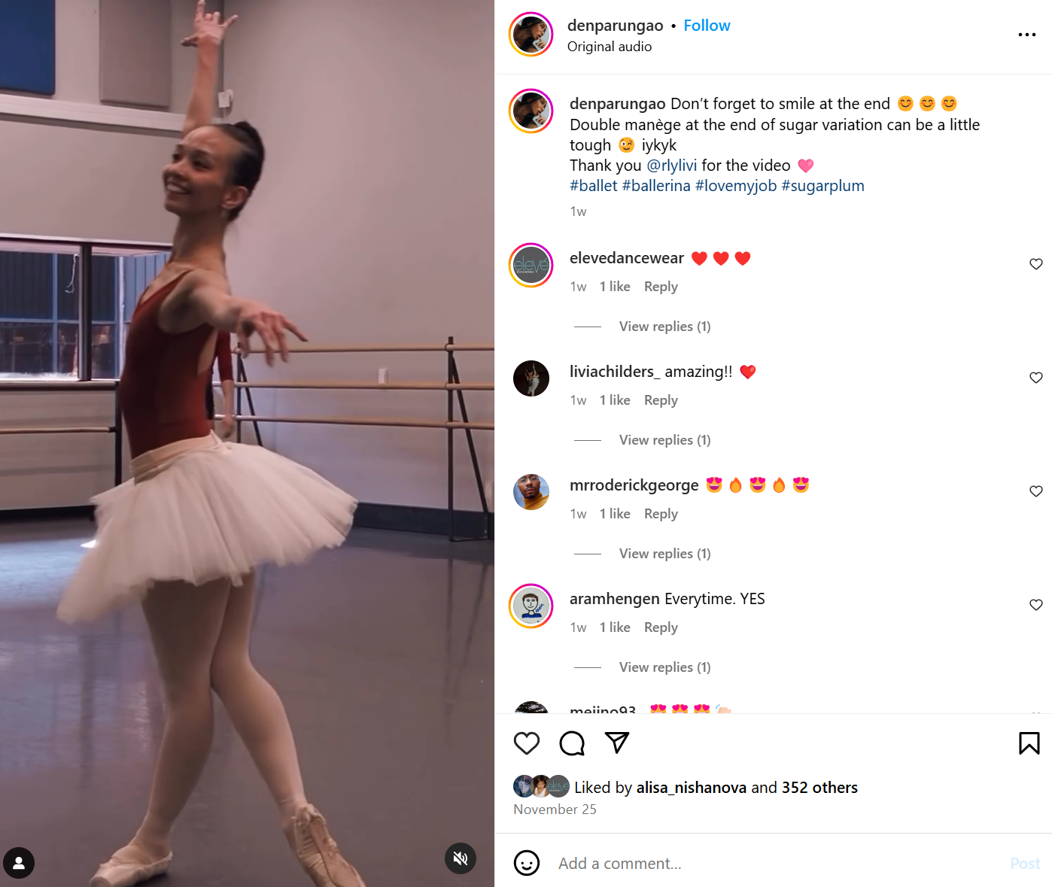
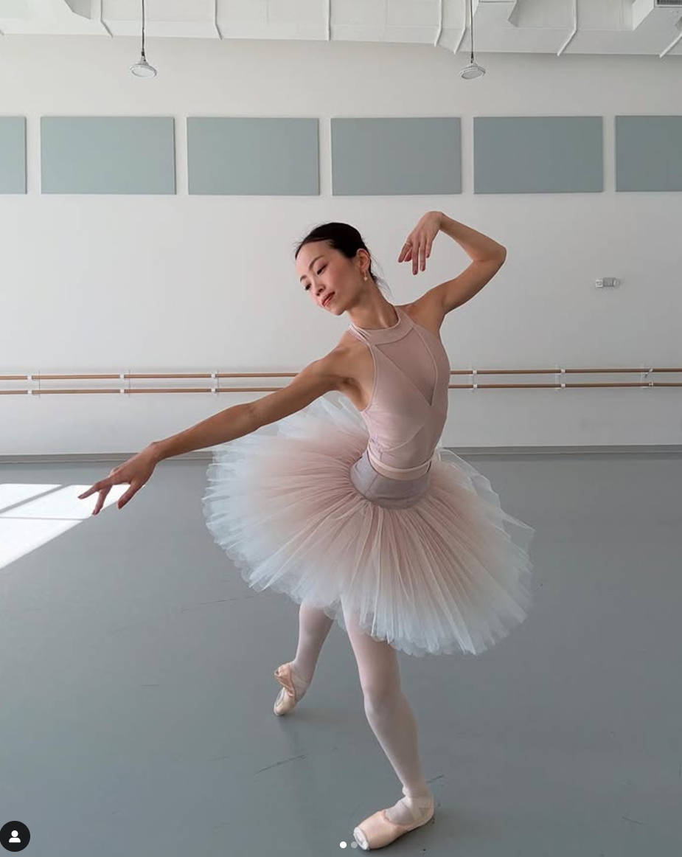
Eleve’s content
Should post more professional dancers in their products
Less about students, more for working dancers
Make their new discount known
Possible Hashtags:
#ballet
#ballerina
#leotards
#elevedancewear
#boysdancetoo (for the male demographic)
#supportsmallartists
#dancersofinstagram

Slide 15
Audience engagement & Development
Make use of the hashtag #elevedancewear so customers will use it as well
Go live on Instagram with new and exciting news
Make sure the posts are linked to the website for direct access
Work with professional companies to establish a relationship with employed dancers

Slide 16
citations
Elevé Dancewear (@elevedancewear) • Instagram photos and videos
Adobe Firefly
https://www.instagram.com/hitominachan?utm_source=ig_web_button_share_sheet&igsh=ZDNlZDc0MzIxNw==
https://www.instagram.com/denparungao?utm_source=ig_web_button_share_sheet&igsh=ZDNlZDc0MzIxNw==

Slide 17
Thank you

